Slide 1

Valentina's Path to Marine Biology
A planning roadmap. Junior year, Class of 2027.

Slide 2
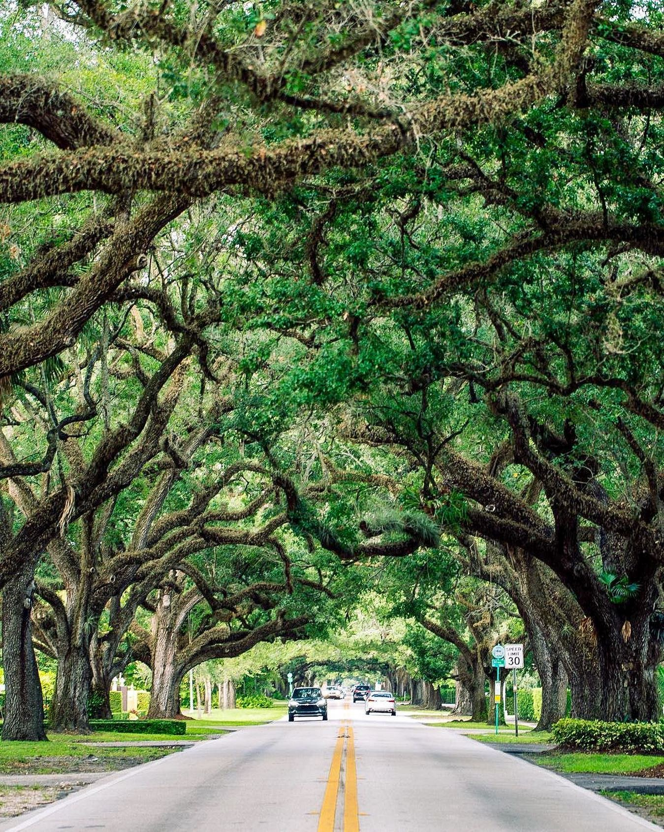
The Goal
Clear targets make the work concrete
• A marine biology major, the through line of every course choice
• A target SAT of 1400, realistic from the current trajectory
• A shortlist of six Florida and out of state programs
• Fund the first two years in state from the 529 plan
• Applications open in the fall of senior year
Strong in the sciences, around a 3.7 weighted GPA

Slide 3
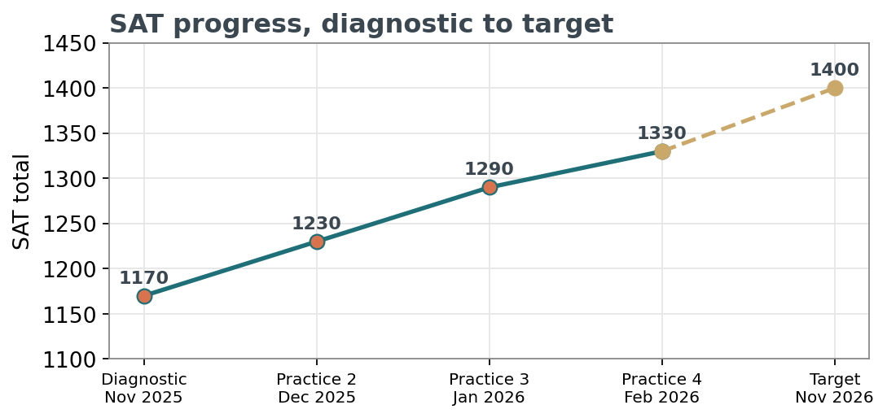
SAT, Climbing on Schedule
One hundred sixty points gained since the diagnostic
Reading is already strong. The remaining gains sit in advanced algebra and data analysis.
Weekly sessions continue through the spring, with a focused review before the November test.
Target test date, November 7, 2026

Slide 4
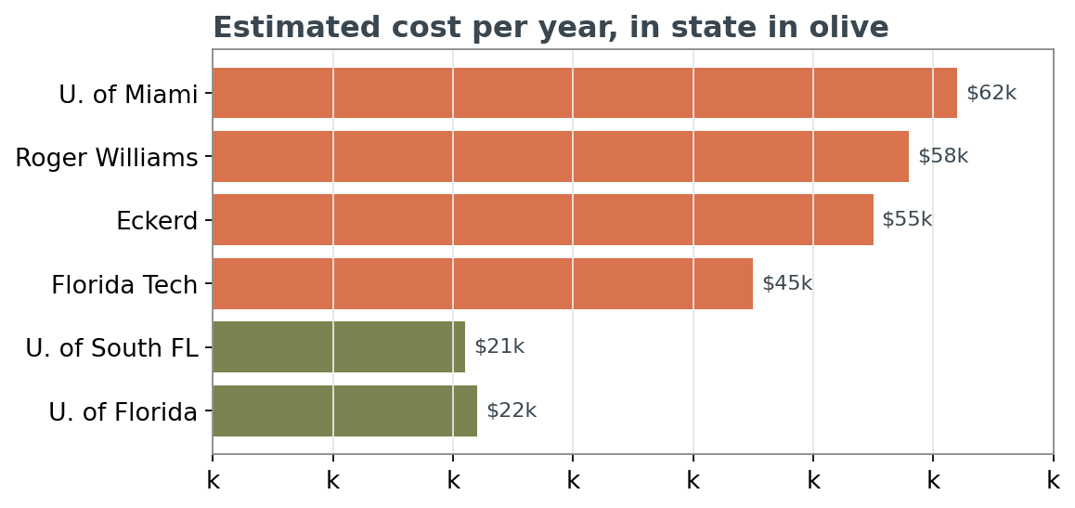
Six Schools, Real Choices
Cost is part of the conversation, not an afterthought
In state programs keep the 529 stretching further. The state flagship and the St. Pete campus on the water are the value picks.
The reach schools stay on the list, paired with a real scholarship plan.
Visit the close to home option and the small college over winter break

Slide 5
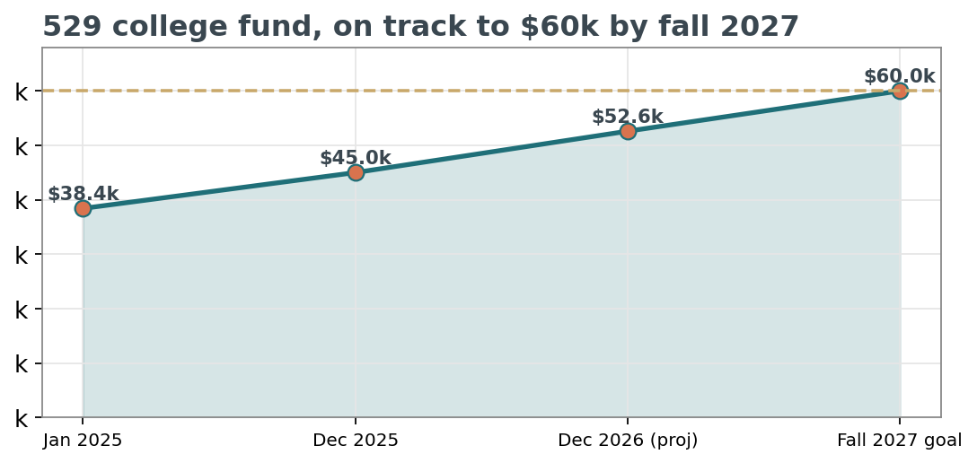
Paying For It
The 529 is on track to its goal
75%
Of the $60,000 goal already saved
$300 / mo
Auto transfer, plus periodic lump gifts
Target reached before fall 2027 applications

Slide 6
Timeline and Next Steps
The next twelve months, in order
This fall
Lock the SAT review schedule. Confirm the November test seat.
November 2026
Early action deadlines for the in state and reach schools, most on the first.
Winter break
Campus visits to the close to home and small college options.
Senior year
Submit applications, line up scholarship and aid paperwork early.
Reviewed with Valentina, kept on the family calendar

